Slide 1
Navigation Group.
Week Eleven Progress Report.

Slide 2
GPS Module Progress.
The newly acquired GPS module has been excellent in pinging the location and also has been able to help us test the codes that had been previously written by the group members.
Unfortunately we got several issues on the way that we would like to mention in passing as we were able to solve all but some:
We had to create a new input ort to power up the motor wheels. This involed purchase of a DC input port.
We report that the motor shield we previously had purchased was indeed subper as it dropped down the voltage supply to the wheels and at times no power was detected at its pin outs.
We tested the codes and the robot is well responding to the codes but failure to stop had made us to think of differently on our code.
A complication on the availabilty of the electromechanical systems that were to be used on the tractor for bracking.

Slide 3
Remedies.
We replaced the end of one of the charging cables to incoorporate the DC input port.
We replaced both the arduino mega and the motor shield to test the robot.
We changed the code for the gps module. This was to make use of the Haversine algorithm to use the earth’s radius as reference point for the distances.
We have assembled the ardupilot system and currently through Omar Waka the software will be up and running in the coming week.
Further enquiry on the shops that deliver electric car systems for much better conclusions on what to purchase since it has been a difficulty in acquiring what we had listed on the list of components to be purchased.

Slide 4
Objectives to be completed the following week.
A correction of the robot to make it halt at the position given on the code.
Assemble the motor wheels with the Ardupilot to work as a substitute or the primary GPS control to use on the electric tractor depending on the accuracy of the distances and the responses of the motor wheels on the robot.

Slide 5
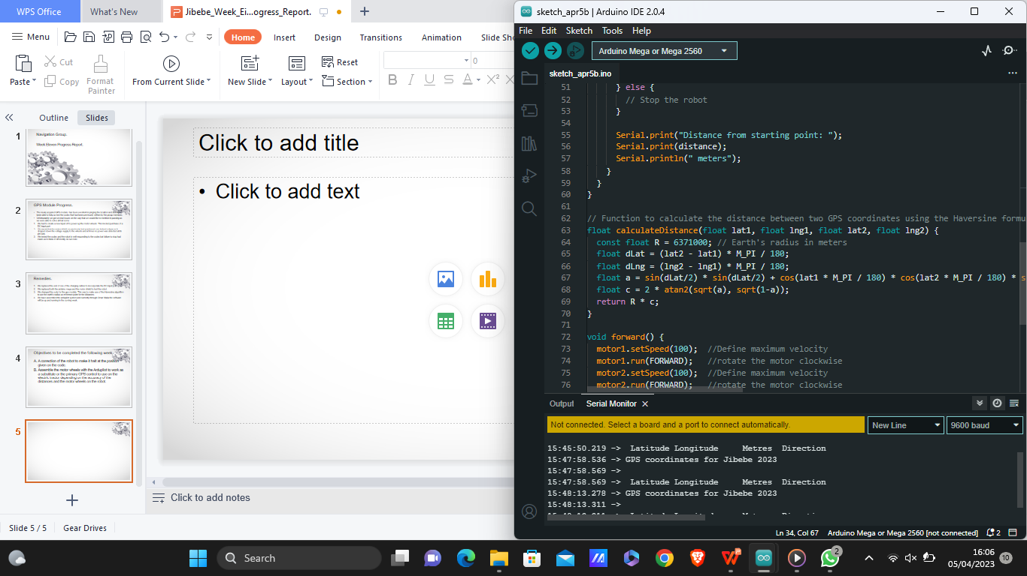
A copy of the haversine formula.

